Slide 1
Virtual Stock Market
Shikhar Shah
Shrey Pateliya

Slide 2
About System
An virtual Stock Market is a virtual Place where Company can sell their stock and trader can buy those stock and sell them to other traders.
Here there is Almost no Physical commerce involved. Every trade will be carried out on the site.
The system will have four main users:
Guest
Admin
Company
Trader

Slide 3
About System
The admin will have superior authority over the system. The admin can add users, remove user, remove stocks, can monitor sales and can do much more.
The company is the one that will be sell its stock on the site. Whenever the company wants to go public they can register on the site and after the admin verifies the company it will be allowed to trade on the site.
The trader will be able to buy and sell company’s stock and sell those stocks to other users. The trader will be able to search stocks, search company, see company’s details, see the performance of the share and do much more.

Slide 4
Features and Tools used
To develop this system the features and tools used are:
Visual Studio: A tool used for developing an application in .NET Framework.
Asp.net: Language Used to Create Dynamic and user friendly pages.
C#: Used to develop web application as well as mobile application

Slide 5
Detailed Description of System
Existing System
In a tradition stock market the stocks are usually traded in a physical market place (trading floor). People have to hire brokers to trade who charge some percentage of the trade as their fees.
So to sell a share the trader would first get the price of a share the contact their broker to sell it, upon receiving this message the broker would submit a sell order of that share and then wait for a buy order.
Same thing happens while buying shares. The trader would get the price and contact the broker to buy those share. Then the broker looks for a sell order and then buys those share.
This is a time consuming work.

Slide 6
Detailed Description of System
Proposed System:
In the proposed system the trading is going to be performed on a virtual market. Here a physical trading floor is not required.
The traders now do not need to hire broker the system will allow them to perform trading through their handheld devices. Trading process will become more simple. The users can get details of share and company that they are investing in. the users can see the performance of the share over time through its historical prices.
Here geographical barrier will be removed and users can trade share from around the world. This will allow company to have a global reach and will make it easier to raise funds.
The broker will be removed and so is its brokerage, this will benefit the user.

Slide 7
Feasibility Study
Operational Feasibility:
The System is feasible because it is easy to use by the user and is cost and time effective to both the company and the user.
The company will have a global reach and will have a better way to raise funds. It will also be easier to register on the exchange with this system.
Technical Feasibility:
All the technology to build this system is available. The system is going to deal with a lot of data and this will require a reliable storage server. The price of a share is needed to be calculated through its supply and demand, for this server that can handle this load over the user load is required and is available for building the system.

Slide 8
Feasibility Study
Economical Feasibility:
The System is Feasible because when the company registers on the system it will have pay a fixed amount of fee for scrutiny and the trader will be charged a small amount of the trade carried on the system.
Legal Feasibility:
The system is feasible because government allows registering a stock exchange on through Security and Contracts (Regulation) Act, 1956 (SCRA).
This act provides guidelines for getting your stock Exchange recognized by the Central Government.

Slide 9
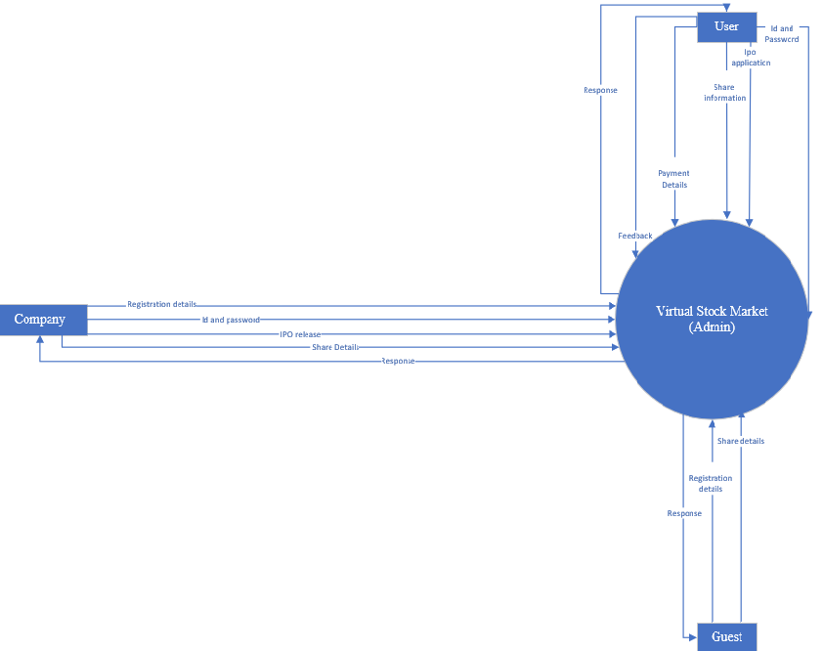
Context level

Slide 10
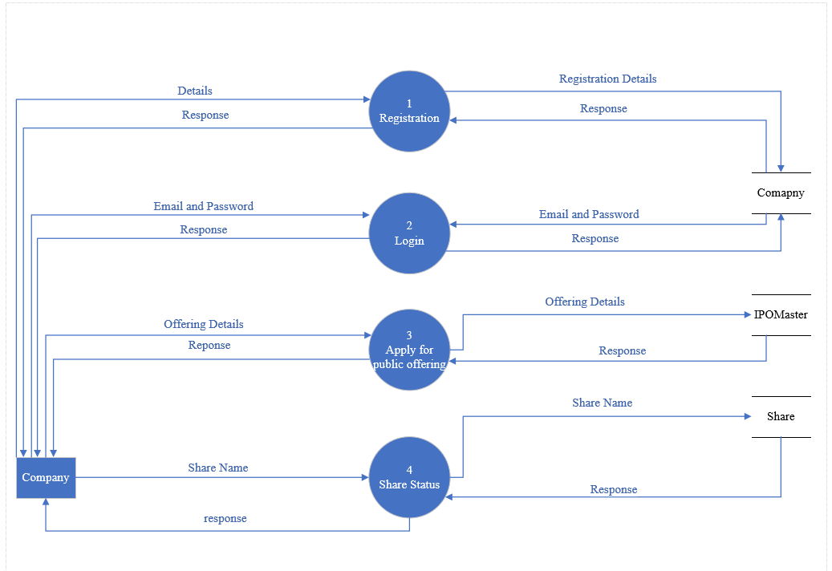
Company Level-1

Slide 11
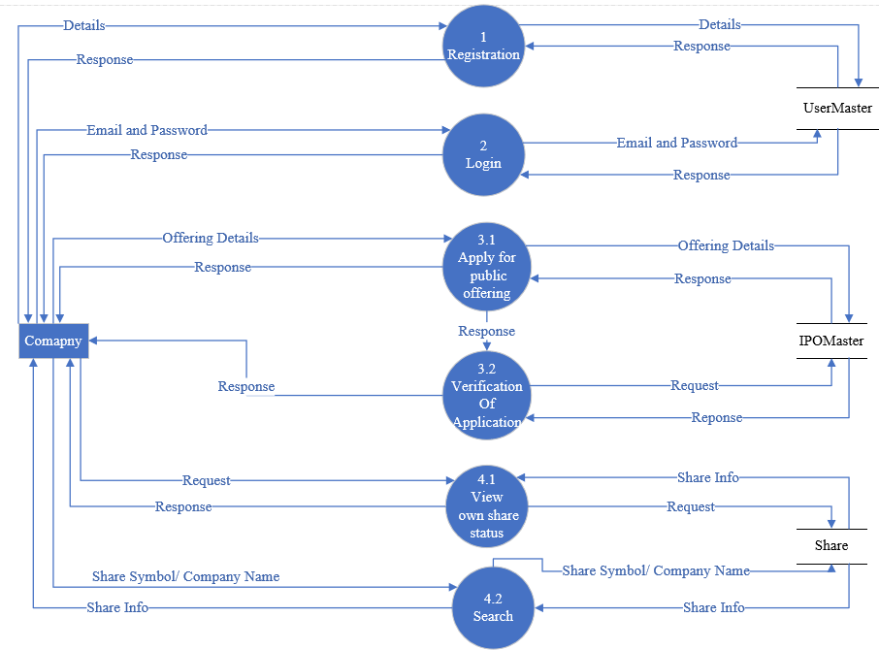
Company level-2

Slide 12
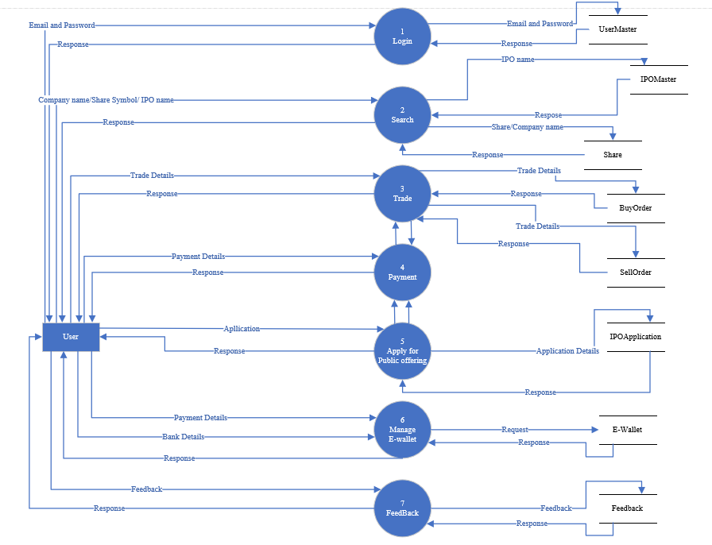
User level-1

Slide 13
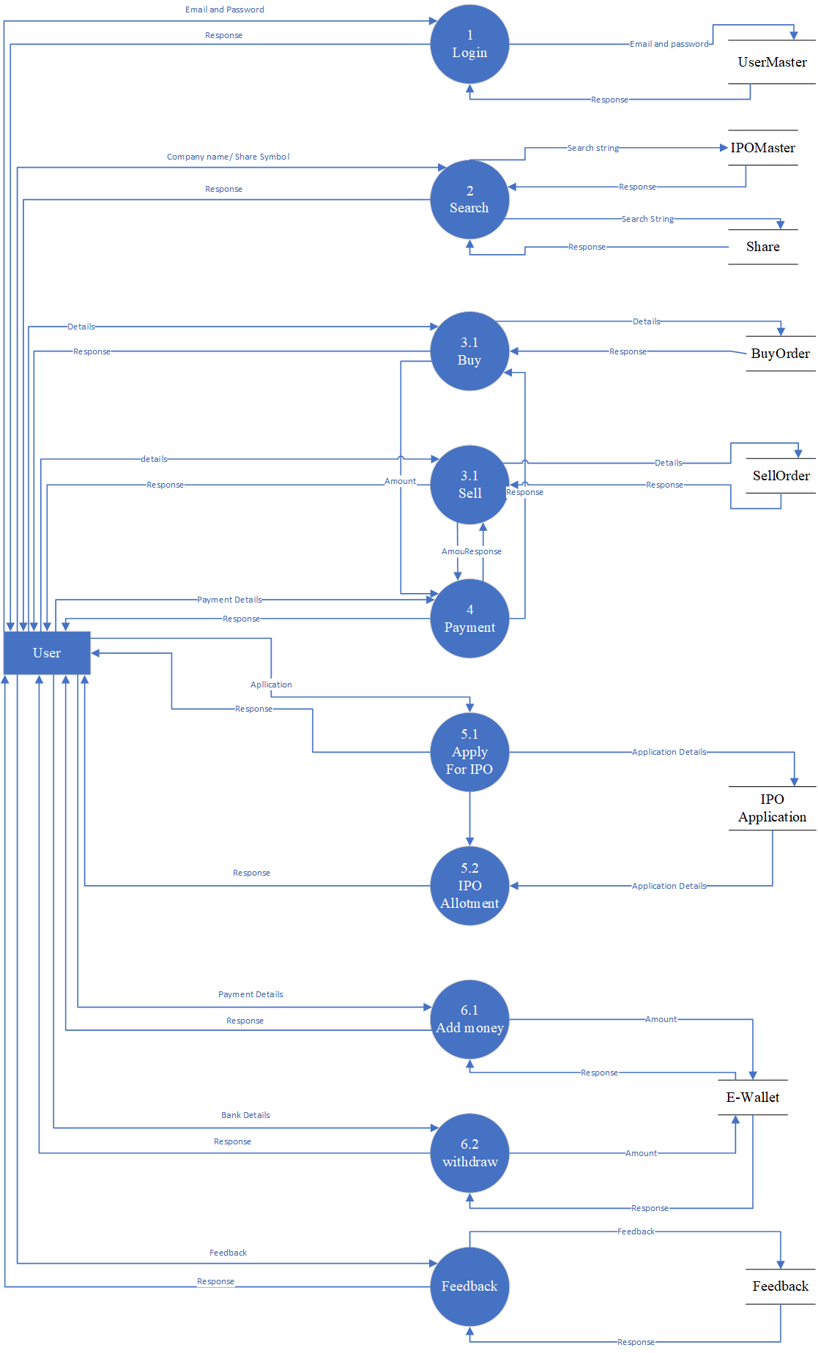
USER LEVEL-2

Slide 14
GUEST LEVEL

Slide 15
Registration flowchart

Slide 16
Login flowchart

Slide 17
Admin flowchart

Slide 18
User flowchart

Slide 19
Company flowchart

Slide 20
Guest Flowchart

